Slide 1

TRIBHUVAN UNIVERSITY
INSTITUTE OF ENGINEERING
Kathmandu Engineering College
Kalimati,Kathmandu
Minor Project Proposal On
Computer Vision Based Virtual Keyboard
By
Deepak Thapa KAT078BCT029
Sudyumna Mishra KAT078BCT083
Sujan Malakar KAT078BCT085

Slide 2
Overview
Introduction
Problem Statement
Objectives
Scope and Applications
Tools to be used
Process Model
System Block Diagram
Flowchart
Tools To Be Used
Expected Output
Gantt Chart
References

Slide 3
1. Introduction
What is Computer Vision?
It is a field in AI that uses machine learning and convolutional neural networks to teach computer to derive meaningful information from visual inputs like images, videos, etc to perform various actions based of these input and programs logic.
What is Computer-vision based virtual keyboard?
It is a virtual keyboard system that uses computer vision technology to track and interpret the movements of user’s fingers or hands and allows the user to type on virtual keyboard displayed on a screen or projected surface.

Slide 4
2. Problem statement
Not many CV based program available in mainstream market.
Available programs are usually trapped behind certain expensive hardware. Example: Apple Vision Pro
Physical keyboards can be unsanitary in public areas as many people use it.

Slide 5
3. Objectives
To make a virtual keyboard with all basic functionality and additional accessibility features taking disabilities to consideration.
To make a program that allows user to access perform various computer functionality including but not limited to volume control, brightness control and mouse navigation using finger pattern recognition.

Slide 6
4.Scope and Applications
Provide alternatives for input to people with certain physical disabilities finding difficult to use physical keyboards.
Enhance gaming experiences providing immersive way to control characters.
Reduce risk of germ spreading making it useful for clinics, hospitals and public terminals like ATMs.
Allow text input and control in wearable devices like smart glasses, smart watches and medical wearables.

Slide 7
5. Tools To Be Used
Python
Python is a computer programming language used to build websites, software, automate tasks and analyze data and supports multiple programming paradigms.
OpenCV
OpenCV (Open-Source Computer Vision Library) is a free cross-platform computer vision library for real time image processing.
Mediapipe
Mediapipe is an open source and flexible framework for building multimodal ML pipelines allowing developers to create complex processing graphs for audio, image and sensor data.
Visual studio code
Visual Studio Code is a free code editor that can be used with a variety of programming languages for operations like debugging, task running, and version control.

Slide 8
6. Literature Review
Apples New Product called Apple Vision Pro utilizes CV and Virtual Keyboard
Dr. Fei-Fei Li was a Professor of Computer Science at Stanford University and co-director of the Stanford Vision and Learning Lab. Her research focuses on computer vision, machine learning, and cognitive neuroscience, all of which are fundamental to virtual keyboard development.
Few videogames from Nintendo uses CV and Virtual Keyboard.

Slide 9
Difficulties in Existing Systems
Lack of features like autocorrect and word suggestions
Lack of shortcuts due to limited gestures
Existing systems being tied down to expensive hardwares.
Solutions Proposed by our System
Addition of features like AI-based autocorrect, word suggestions
New gestures for shortcuts
Optimizing software for smooth running and cost effectiveness.

Slide 10
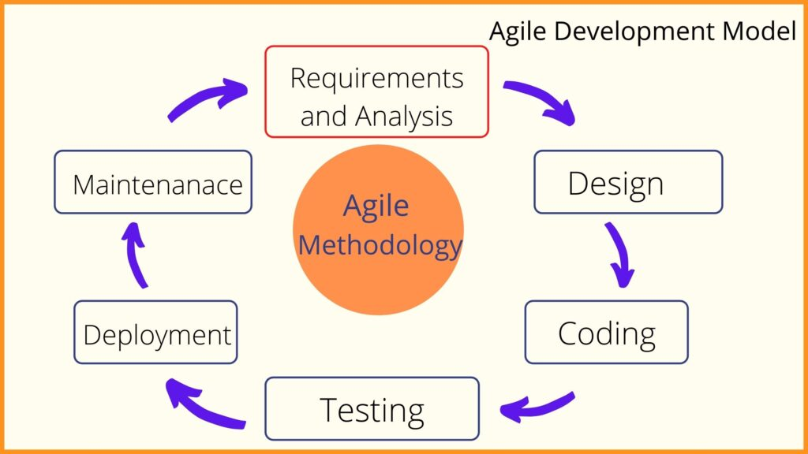
7. Process Model
Fig: Agile Model

Slide 11
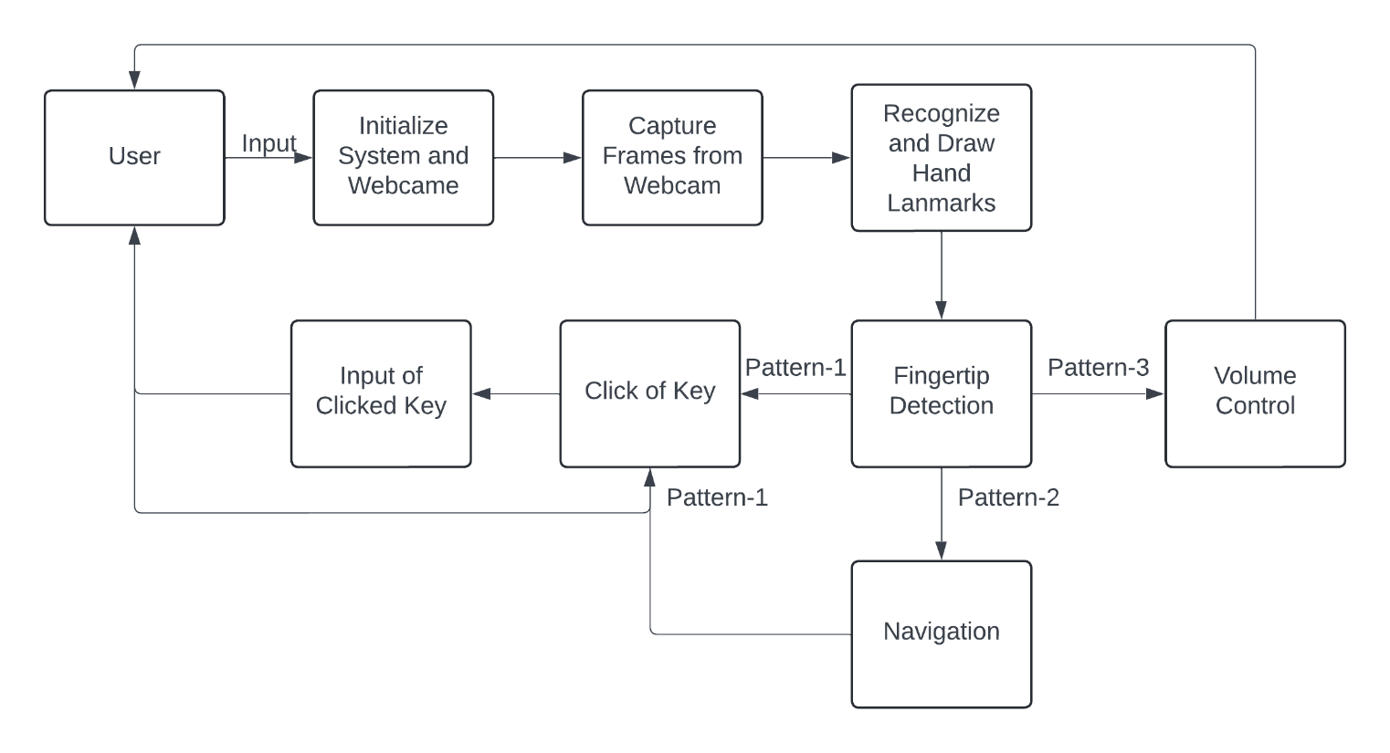
8. System Block Diagram

Slide 12
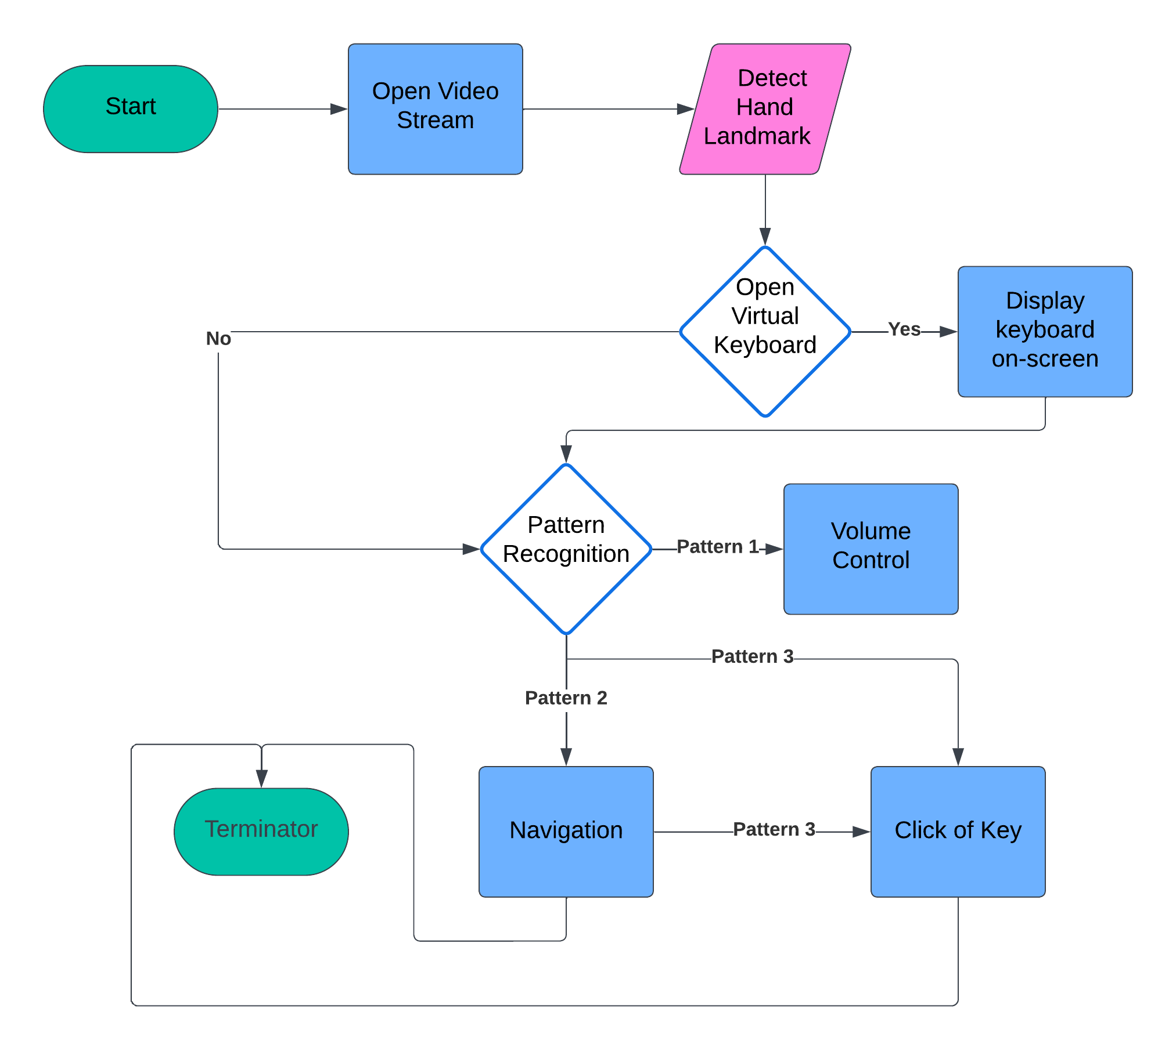
9. Flowchart

Slide 13
10. Expected Output
With the completion of this project a fully functional, user friendly and accessible virtual keyboard using CV will be presented. User can interact with keyboard on screen using Hand Gestures without needing to physically interact keyboard.
Similarly more features to improve the keyboard itself as well as utilization of other Computer functionalities using Computer Vision will be added

Slide 14
Additional Features
Virtual Mouse for easier navigation of computer using CV will be added.
Shortcuts for features like Copy/Paste and Brightness Change and Volume control.
Word recommendation based on Users Past Input using AI will be added.

Slide 15
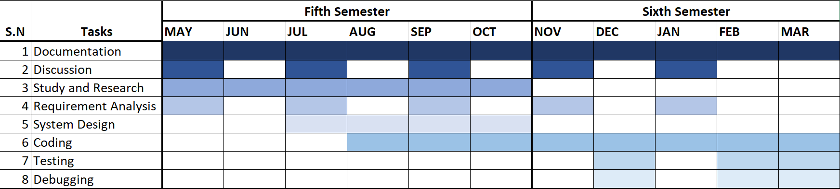
11. Gantt Chart

Slide 16
12. References
Li, Fei-Fei, et al. "Virtual keyboards for mobile devices: state-of-the-art and future directions." ACM Transactions On Computer-Citationhuman Interaction (TOCHI) 18.3 (2011): 1-38.
Wenbin Li, Jianhui Chen, and Wei Huang: A Computer Vision-Based Virtual Keyboard System for Chinese Handwritten Input" (International Conference on Intelligent Computing, 2009).

Slide 17
THANK
YOU

